Slide 1
Linked List

Slide 2
Linked list
A data structure in which each element is dynamically allocated and in which elements point to each other to define a linear relationship
Singly- or doubly-linked
Stack, queue, circular list

Slide 3
Linked list
A linked list is a series of connected nodes, where each node is a data structure.
A linked list can grow or shrink in size as the program runs
item
next
a_{i}
head
represents
null
a₁
a₂
a₃
a₄

Slide 4
Linked list
typedef struct node Node;
struct node
{
int data;
Node* next;
};
A node is dynamically allocated
Node* temp;
temp=(Node*)malloc(sizeof(Node));

Slide 5
Linked list
A linked list can easily grow or shrink in size.
Insertion and deletion of nodes is quicker with linked lists than with vectors
Need to add and delete data “on the fly”
Even from middle of list
Items often need to be added to or deleted from the “ends”

Slide 6
Linked list
a
c
a
c
b
b
h
h
p
p
p

Slide 7
Linked list - traversing
Reference a node member with the -> operator
p->item;
A traverse operation visits each node in the linked list
A pointer variable cur keeps track of the current node
for (Node *cur = head; cur != NULL; cur = cur->next)
x = cur->item;

Slide 8
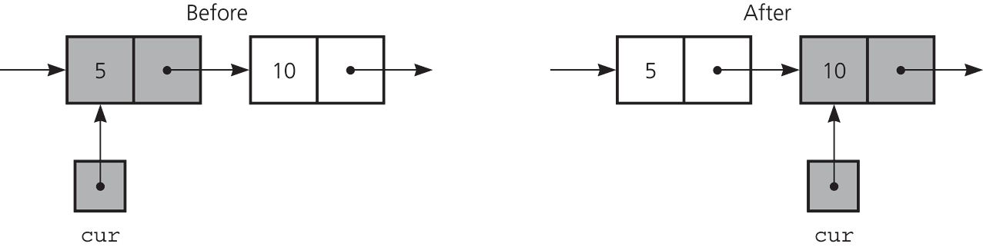
Linked list - traversing
The effect of the assignment
cur = cur->next

Slide 9
Linked list – delete a Node
Deleting an interior/last node
prev->next=cur->next;
Deleting the first node
head=head->next;
Return deleted node to system
cur->next = NULL;
free(cur);
cur = NULL;

Slide 10
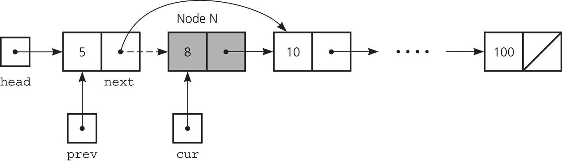
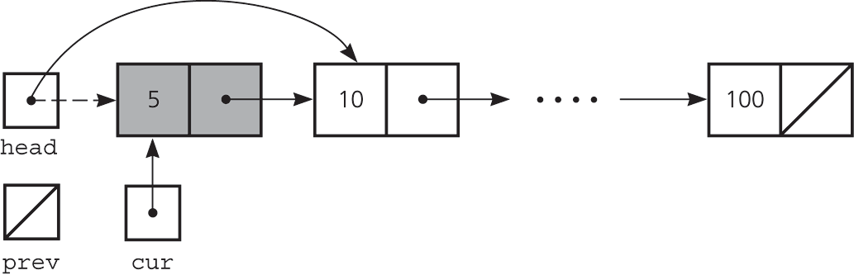
Linked list – delete a Node
Deleting a node from a linked list
Deleting the first node

Slide 11
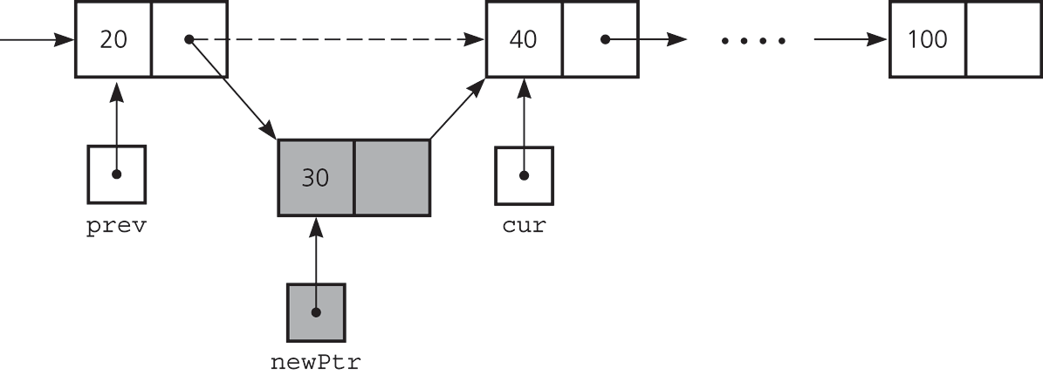
Linked list – insert a Node
To insert a node between two nodes
newPtr->next = cur;
prev->next = newPtr;

Slide 12
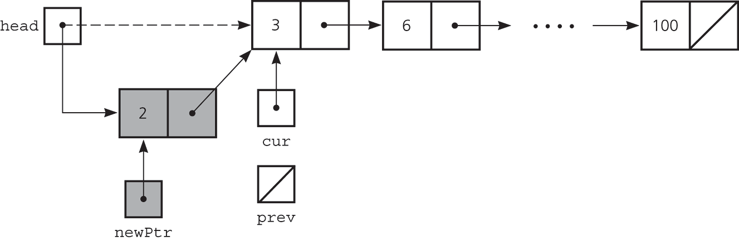
Linked list – insert a Node
To insert a node at the beginning of a linked list
newPtr->next = head;
head = newPtr;

Slide 13
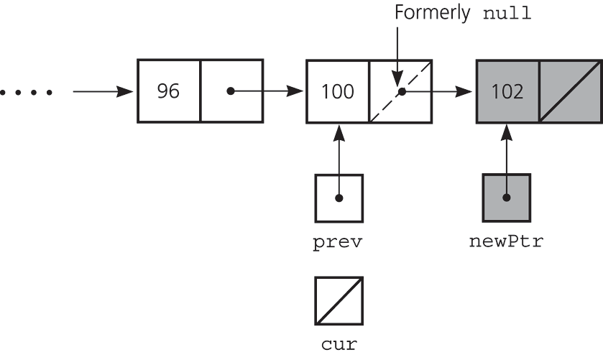
Linked list – insert a Node
Inserting at the end of a linked list is not a special case if cur is NULL
newPtr->next = cur;
prev->next = newPtr;

Slide 14
Doubly-Linked list
Frequently, we need to traverse a sequence in BOTH directions efficiently
Solution : Use doubly-linked list where each node has two pointers
forward traversal
Doubly Linked List.
next
head
x₁
x₂
x₃
x₄
prev
backward traversal

